Slide 1

MOVIELENS RECOMMENDATION SYSTEM
By Cecilia Ngunjiri

Slide 2
PROBLEM STATEMENT AND OBJECTIVES
Problem Statement;
This project aims to design and implement a data-driven movie recommendation system using the MovieLens dataset. The system will utilize collaborative filtering techniques to suggest movies to users based on their preferences and viewing patterns. By analyzing user behavior and movie attributes, the goal is to provide accurate and personalized recommendations that enhance the user experience.
Objectives;
Build a collaborative filtering model that can provide the top 5 recommendations for a user.
Use matrix factorization techniques such as Singular Value Decomposition (SVD) to capture latent features of users and movies.
Address the cold start problem (when new users or movies enter the system) through a hybrid approach.
Evaluate the system using RMSE and MAE to ensure the quality of predictions.

Slide 3
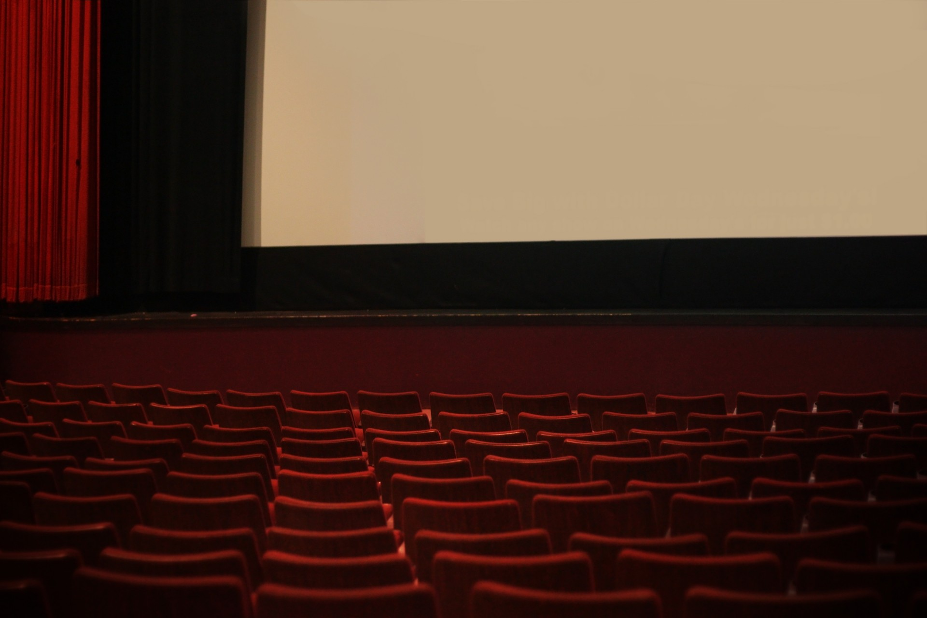
DATA Limitations
Cold Start Problem: New Users: For users with no prior ratings or interactions, relying on popular movies may not align with their actual preferences, leading to potentially irrelevant recommendations.
Limited Contextual Understanding: The system may not consider contextual factors (e.g., time of year, user mood, or current events) that influence movie preferences, limiting the relevance of recommendations.
Limited Feedback Loop: The system may lack a robust mechanism for incorporating user feedback into the recommendation process, potentially leading to stagnation in improvement.
User Behavior Dynamics: Changing Preferences: User tastes can change over time due to various factors (life changes, exposure to new genres), making static models less effective at capturing current interests.

Slide 4
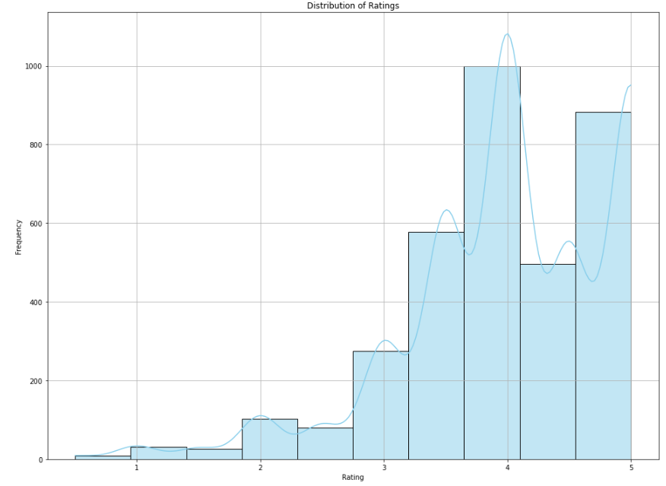
Distribution of ratings
Visual representation of how ratings are distributed in the dataset, making it easy to identify patterns

Slide 5
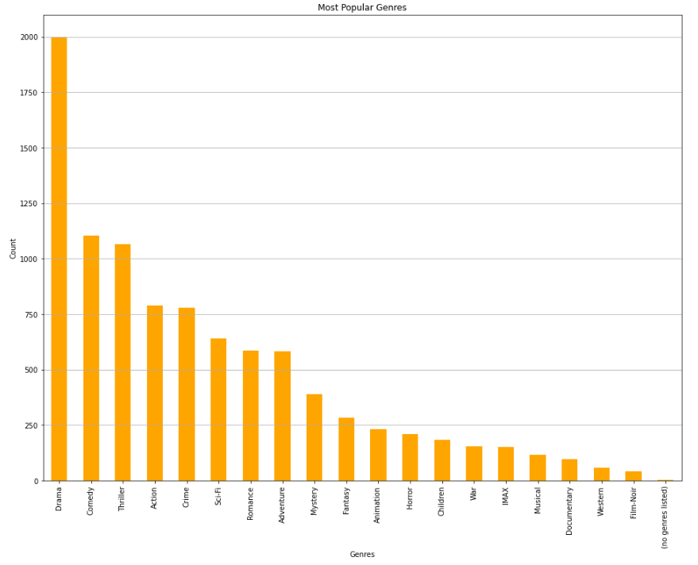
Most popular genres
- Visual representation of the counts of different movie genres, helping to identify which genres are the most popular based on the number of movies in each genre within the dataset
- Drama is the most popular genre, meaning that most movies released are in the drama genre and the second most popular genre is comedy.

Slide 6
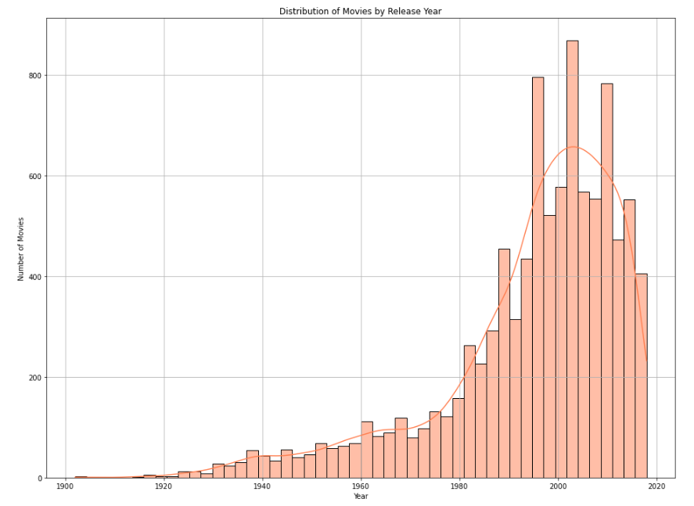
DISTRIBUTION OF MOVIES BY RELEASE YEAR
- Visualizes the distribution of movie releases over the years, helping to identify trends in film production
- Most movies seem to have been produced around the 19880s to 2000s
- However, there is a decline in the production of movies towards the year 2010s to 2018

Slide 7
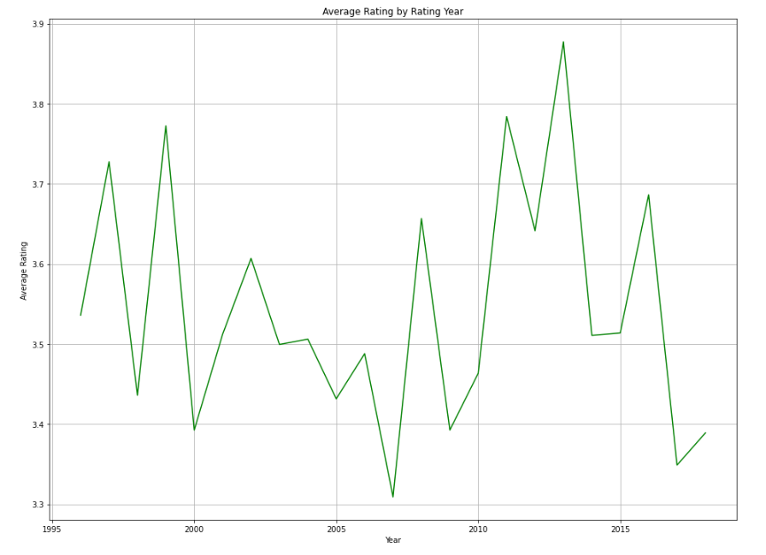
AVERAGE RATING BY YEAR
- Fluctuations in Average Ratings: fluctuations in average ratings from 1995 to 2015. It appears that there are peaks and troughs, indicating varying levels of user satisfaction with movies over time
- High Points: Around 2014s, there are high points in the average ratings, reaching almost 3.8. This suggests that users rated movies higher during these years compared to other periods.

Slide 8
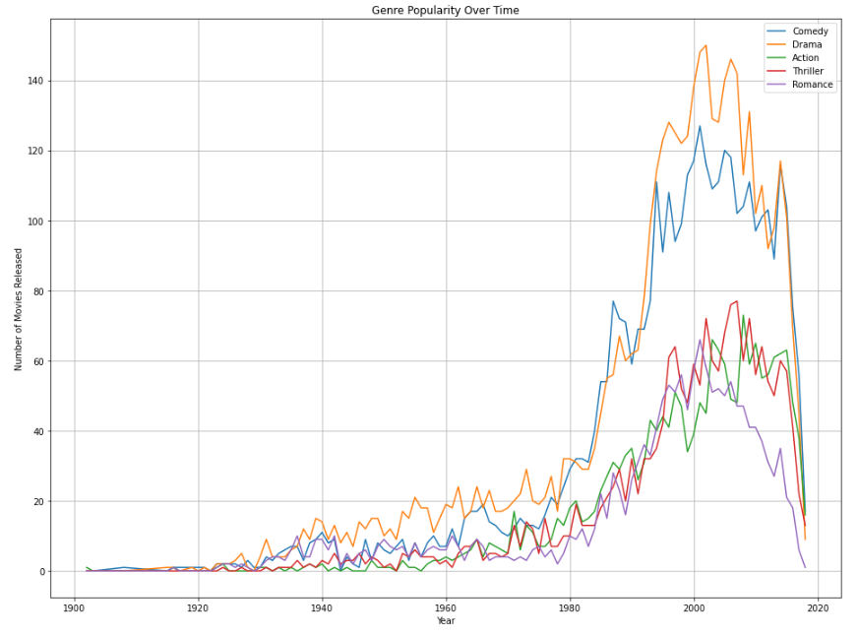
GENRE POPULARITY OVER TIME
- Drama and Comedy consistently release the highest number of movies across most time periods, especially during the 1990s and 2000s
- Action and Thriller genres saw a rise in popularity starting around the 1980s, peaking around the 1990s and 2000s.
- There is a noticeable decline in all genres after 2010. This might be due to several factors, such as changes in the movie industry, the rise of streaming platforms, or changes in consumer preferences

Slide 9

Baseline model, content-based model, collaborative filtering model
Content based model based on content. By analyzing the combined features of genres and tags, you find movies that are similar to one another. This is useful in scenarios where you want to recommend movies to a user based on a movie they liked or are currently viewing
A collaborative filtering recommendation system based on user similarity. By calculating the cosine similarity between users and setting up a nearest neighbors model, you can easily find users who have similar rating patterns. This information can then be used to recommend items based on what similar users have liked or rated highly
Baseline model that serves as a point of reference for evaluating the performance of more complex models
Collaborative filtering recommendation system using SVD to predict how users might rate movies they haven’t seen based on patterns in the existing ratings.
Baseline SVD RMSE: 0.306 meaning the predicted ratings deviate from the actual ratings by about 0.306 points

Slide 10

Conclusions
Effective Use of Collaborative Filtering: The collaborative filtering method leverages user-item interactions to suggest movies based on similar users’ preferences. This method can yield personalized recommendations for known users effectively.
Handling New Users with Popular Movies: For new users, who lack interaction history, the system utilizes popular movies instead of random selections. This approach increases the likelihood of user engagement by recommending well-received films.
Content-Based Filtering for Specific Recommendations: Content-based filtering provides recommendations based on the characteristics of movies (e.g., genres, tags). This is especially useful when a specific movie is provided, allowing for targeted suggestions.
RMSE as an Evaluation Metric: The use of RMSE (Root Mean Squared Error) provides a quantitative measure of the prediction accuracy of the model. This is essential for assessing the effectiveness of the recommendation system.

Slide 11

Recommendations
Refine Collaborative Filtering: Continuously update the user-item matrix to incorporate new user interactions. This ensures that the model remains accurate and reflective of current preferences.
Enhance Content Features: Consider expanding the features used in content-based filtering. Incorporating additional metadata such as director, actors, or reviews could improve the quality of recommendations.
Dynamic Popular Movie List: Regularly update the list of popular movies based on recent trends, seasonal releases, or user feedback to keep the recommendations relevant.
Location-Based Profiles: Integrate location as a factor in user profiles. This could allow for more refined recommendations, combining both the user’s historical preferences and regional popularity.

Slide 12

Thank you
Cecilia Ngunjiri

